Slide 1

CFD source code management with Git and GitHub
- Seminars in Fluid mechanics
Shijie Xu, Ph.D. Student
Dept. of Energy Sciences
Lund University
Oct. 16, 2020
Lund, Sweden

Slide 2

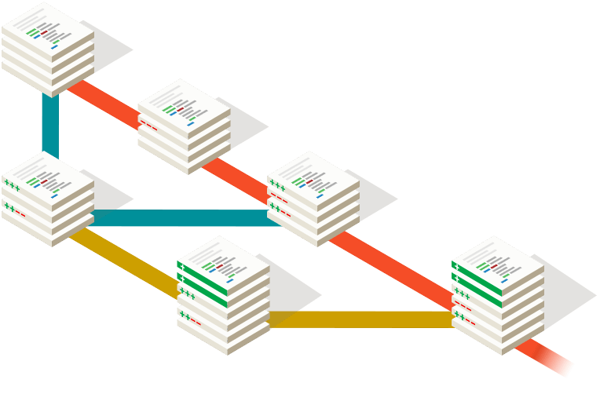
Source Code
Management
Version Control
- git
Teamwork
- github
Notes:
Git abd github

Slide 3
Source Code
Management
Version Control
git
Notes:
Git abd github

Slide 4

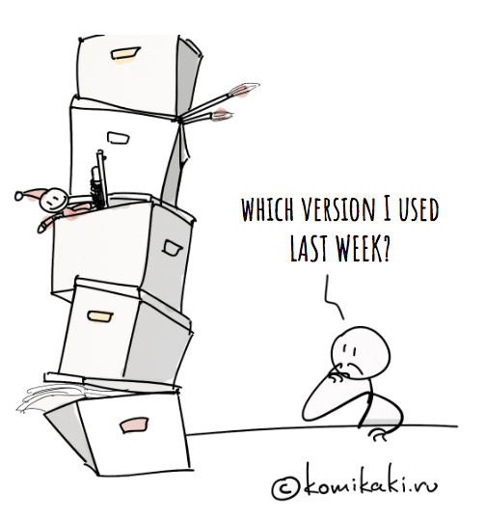
Never revise
version_new
Source Code
Management
Never revise
version
Final
version
cfdFoam
Revised_ Newnew
Notes:
Inevitably, plenty of code version

Slide 5


Workspace
codeCFD.h
codeCFD.c
01
Notes:
Untracked version

Slide 6
init
Workspace
Repository
Temporary storage
Permanent storage
stage
version
codeCFD.h
codeCFD.c
02
Notes:
Tracked version

Slide 7

Workspace
Repository
Temporary storage
Permanent storage
stage
version
codeCFD.h
add
codeCFD.c
codeCFD.h
codeCFD.c
03
Notes:
Tracked version

Slide 8
Workspace
Repository
Temporary storage
Permanent storage
stage
version
codeCFD.h
codeCFD.c
codeCFD.c
codeCFD.h
codeCFD.h
commit
Commit ID: 778a9d
codeCFD.c
Branch:
- master
- dev
04
Notes:
Tracked version

Slide 9
Workspace
Repository
HEAD
stage
version
codeCFD.h
codeCFD.c
codeCFD.c
codeCFD.h
Commit ID: 1d63cea
codeCFD.h
Commit ID: 778a9d
codeCFD.c
Branch:
- master
- dev
05

Slide 10
Workspace
Repository
HEAD
stage
version
codeCFD.h
add
codeCFD.c
codeCFD.c
codeCFD.h
Commit ID: 1d63cea
codeCFD.h
Commit ID: 778a9d
readme.txt
codeCFD.c
readme.txt
Branch:
- master
- dev
Add a file readme.txt
And modify codeCFD.c
06

Slide 11
Workspace
Repository
HEAD
stage
version
codeCFD.h
add
codeCFD.c
codeCFD.c
Commit ID: 1d63cea
codeCFD.h
Commit ID: 778a9d
codeCFD.h
commit
readme.txt
Commit ID: 959c920
readme.txt
codeCFD.c
readme.txt
Branch:
- master
- dev
07

Slide 12
Workspace
Repository
HEAD
stage
version
git reset --hard 778a9d
codeCFD.h
codeCFD.c
codeCFD.c
Commit ID: 1d63cea
codeCFD.h
Commit ID: 778a9d
codeCFD.h
readme.txt
Commit ID: 959c920
codeCFD.c
Branch:
- master
- dev
08

Slide 13


How to install and use git?
GUI (Graphical User Interface):
- Github desktop software
CLI (Command-Line Interface)
- Official document: https://git-scm.com/docs
- My Blog: https://zmeng.tech/2020/06/GitUsage/
An example of CLI git useage
09

Slide 14
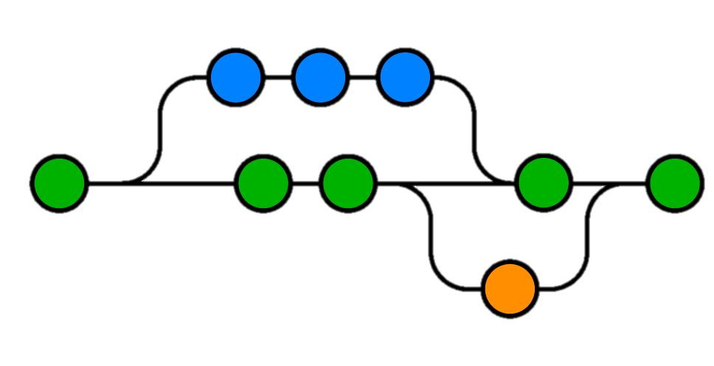
Source Code
Management
Teamwork
- github
Your
work
Master
Someone Else’s work
Notes:
Git abd github

Slide 15
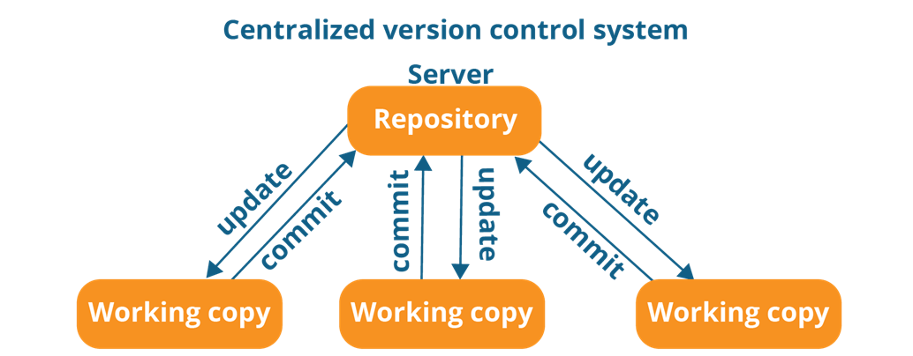

10

Slide 16
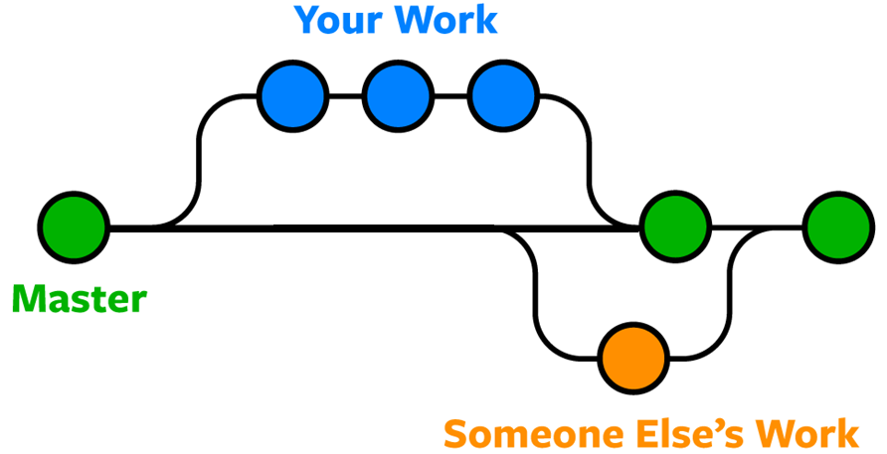
11

Slide 17
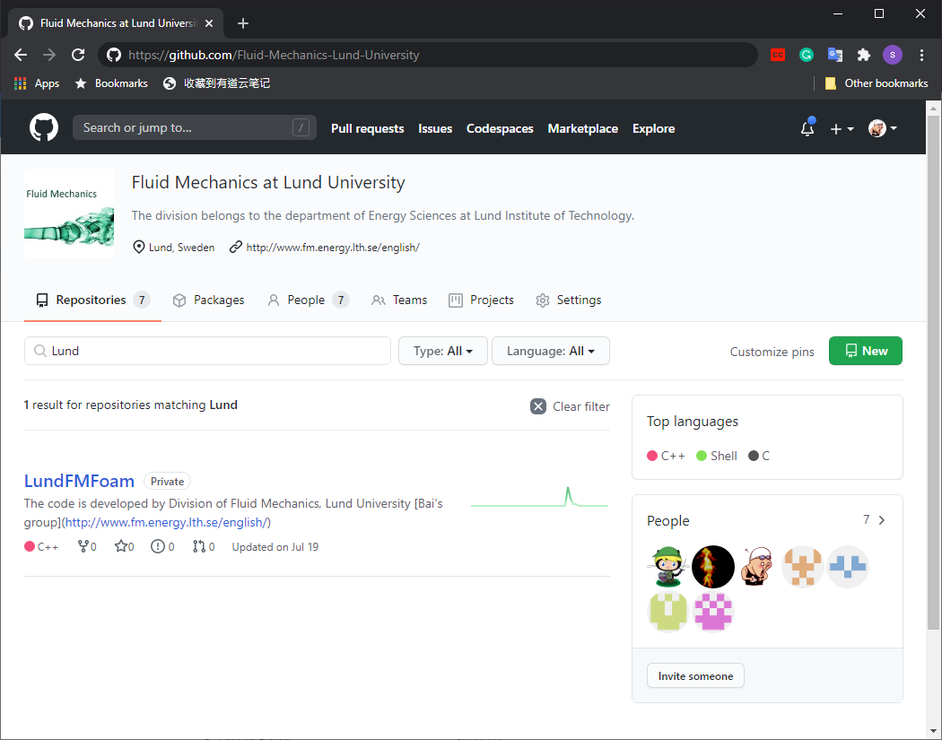
Github
Organization
Webpage: https://github.com/Fluid-Mechanics-Lund-University
Repositories:
Private and public
People:
Group member, Collaborators
Permissions:
Repository permissions for admin, group member and collaborators
12

Slide 18
How to use github?
An example of Github teamwork.
13

Slide 19
Appendix: branches
No conflicts
HEAD
dev
dev
dev
master
master
master
HEAD
master
HEAD
HEAD
conflicts
HEAD
dev
master
master
dev
HEAD
bug
bug
14

Slide 20
Appendix: tags
v1.0
v1.0,min
v2.0
V2.0,min
git tag v2.0
Tags: min
Tags: v2.0
git show min
git show v2.0
v1.0,min
v2.0,min
V2.0,min
v2.0
15

Slide 21

Thank you
Shijie Xu, Ph.D. Student
Dept. of Energy Sciences
Lund University
Oct. 16, 2020
Lund, Sweden

Slide 22
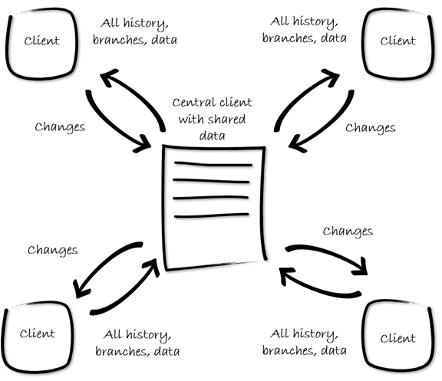

Slide 23
Workspace
Repository
HEAD
stage
version
readme.txt
add
mainCFD.c
mainCFD.c
Commit ID: 1d63cea
mainCFD.h
Commit ID: 778a9d
readme.txt
commit
Commit ID: 959c920
mainCFD.h
mainCFD.c
mainCFD.h
Branch:
- master
- feature
- dev

Slide 24

Hmm, I wonder which one is right?

